Slide 1
Staffing List Reconciliation Focus on Sub 1

Slide 2
AGENDA
1) BASICS
What is it and why have it?
What makes it up?
Balancing the Staffing List
2) TOOLS
Data Warehouse
Open Provision template
Transfer of Funds system
Costing Reports
Reconciliation Worksheet
Salary steps and ranges
3) SUB 1 TRANSACTIONS
New hire
Separation or transfer
Reclassification
Equity adjustment
Merits & range adjustments
Change in FTE

Slide 3
AGENDA
RECONCILIATION EXERCISES
Helpful Hints
Getting Started
Example Set 1
Separation
New Hire
Open Provision update
Example Set 2
Equity increase
Range Adjustment correction
Reclassification

Slide 4
AGENDA
1) BASICS
What is it and why have it?
How is it created?
Balancing the Staffing List
2) TOOLS
Data Warehouse
Open Provision template
Transfer of Funds system
Costing Reports
Reconciliation Worksheet
Salary steps and ranges
3) SUB 1 TRANSACTIONS
New hire
Separation or transfer
Reclassification
Equity adjustment
Merits & range adjustments
Change in FTE

Slide 5
BASICS
What is it and why have it?
What is it?
The Staffing List Detail Report is the vehicle through which each department aligns its Permanent Budget with its permanent staff and faculty salary commitments.
Why have it?
To ensure that each department has, on a permanent basis, sufficient funds to cover salary commitments.
To ensure that merit and range adjustments are properly funded.
To fulfill State of California reporting requirements.

Slide 6
BASICS
How is it created?
The Staffing List Detail Report pulls data from three separate sources:
Permanent Budget Database
PPS Sub 0 and Sub 1 Distributions with indefinite end dates for faculty and staff whose appointments meet certain staffing criteria:
Ladder faculty with indefinite PPS Distribution end dates.
Academic appointments (e.g. Academic Coordinators, Continuing Appointment Lecturers) that have been permanently funded by the Dean’s Office.
Career staff with indefinite PPS Distribution end dates.
Open Provision Database*
The Staffing List combines the data from these three sources and combines them into one report with a section for permanent budget and a salary commitment section that combines PPS Distributions and Open Provisions.

Slide 7
BASICS
* Open Provision Database
The Open Provision Database is a database that creates a “holding place” for a temporarily unfilled appointment that includes the Title Code, salary, and FTE for each record. It can hold a place for a singular appointment or it can be a place holder for multiple appointments. The latter is generally seen only on Control Point staffing lists where colleges may have open group provisions for Teaching Assistant and Professor FTE.

Slide 9
BASICS
Balancing the Staffing List
If the dollars and FTE in the Permanent Budget data equals the dollars and FTE in the PPS & Open Provision data then the Staffing List is considered balanced. If they don’t match, the report can be balanced by making appropriate changes to:
the permanent budget via the Transfer of Funds system
PPS via changes in distributions
the Open Provision database by adding, deleting, or changing provisions
The following slides show a balanced Staffing List and an out-of-balance Staffing List.

Slide 10
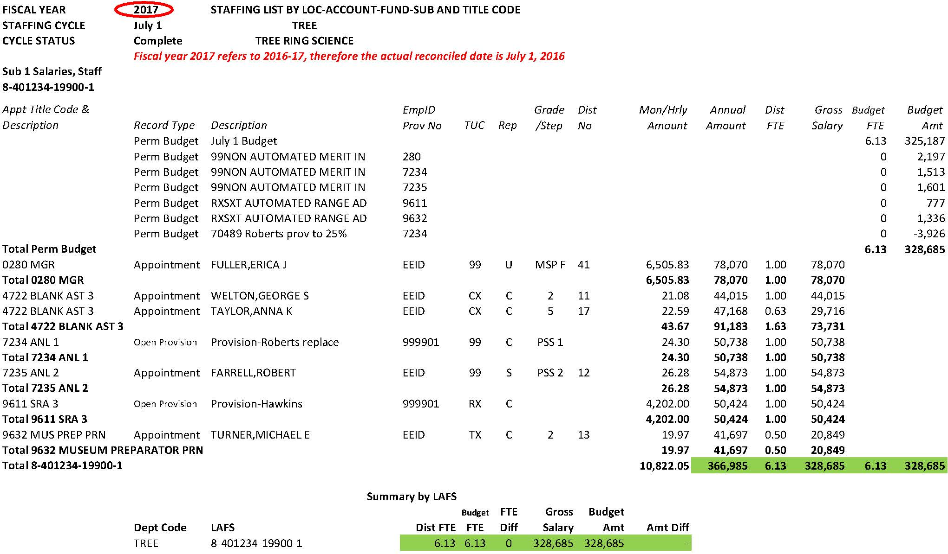
Balanced Staffing List

Slide 11
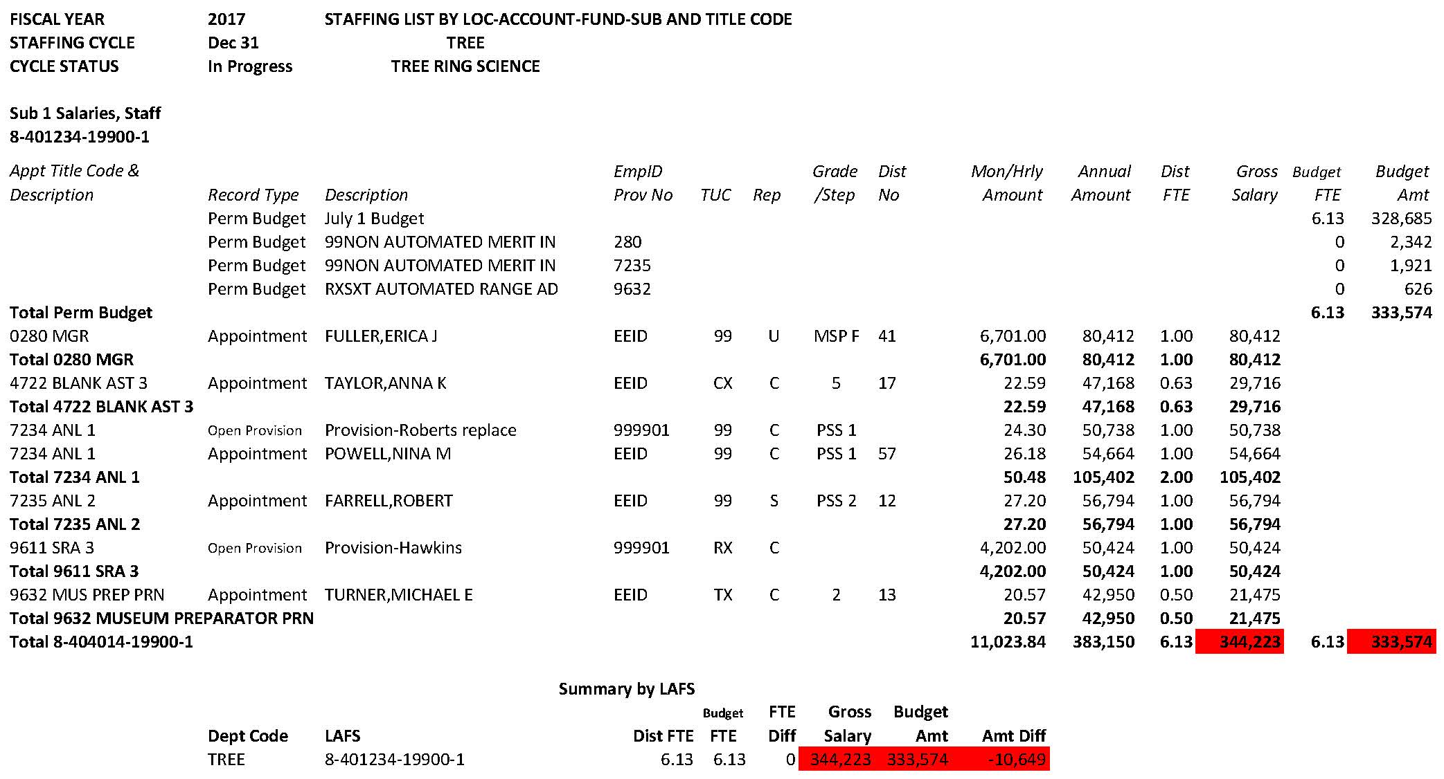
Out of Balance Staffing List

Slide 12
AGENDA
1) BASICS
What is it and why have it?
What makes it up?
Balancing the Staffing List
2) TOOLS
Data Warehouse
Open Provision template
Transfer of Funds system
Costing Reports
Reconciliation Worksheet
Salary steps and ranges
3) SUB 1 TRANSACTIONS
New hire
Separation or transfer
Reclassification
Equity adjustment
Merits & range adjustments
Change in FTE

Slide 13
TOOLS
Data Warehouse
Information on access to the Data Warehouse can be found on the Data Warehouse website.
Staffing List reports are available via DW EZ Access under “Permanent Budget” and “Staffing”. Either report will return the same result.
Reports can be downloaded to Excel and printed or printed to PDF to be used when reconciling. If you download the report to Excel verify that the “Dist FTE” column is wide enough to reflect two places after the decimal so that number isn’t inadvertently truncated on your printed report. Please note, Excel reports are static files and do not contain formulas.
The “Staffing with Page Breaks” report will separate Sub 0 from Sub 1 reports when printed to PDF.

Slide 14
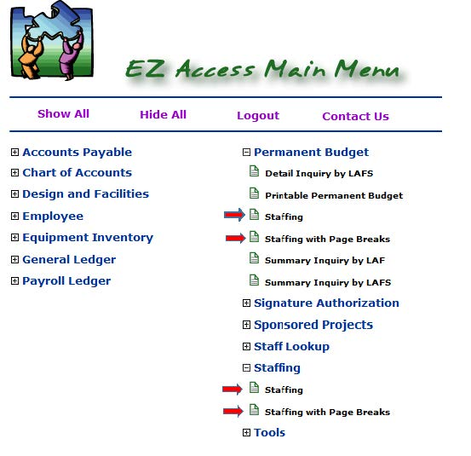

Slide 15
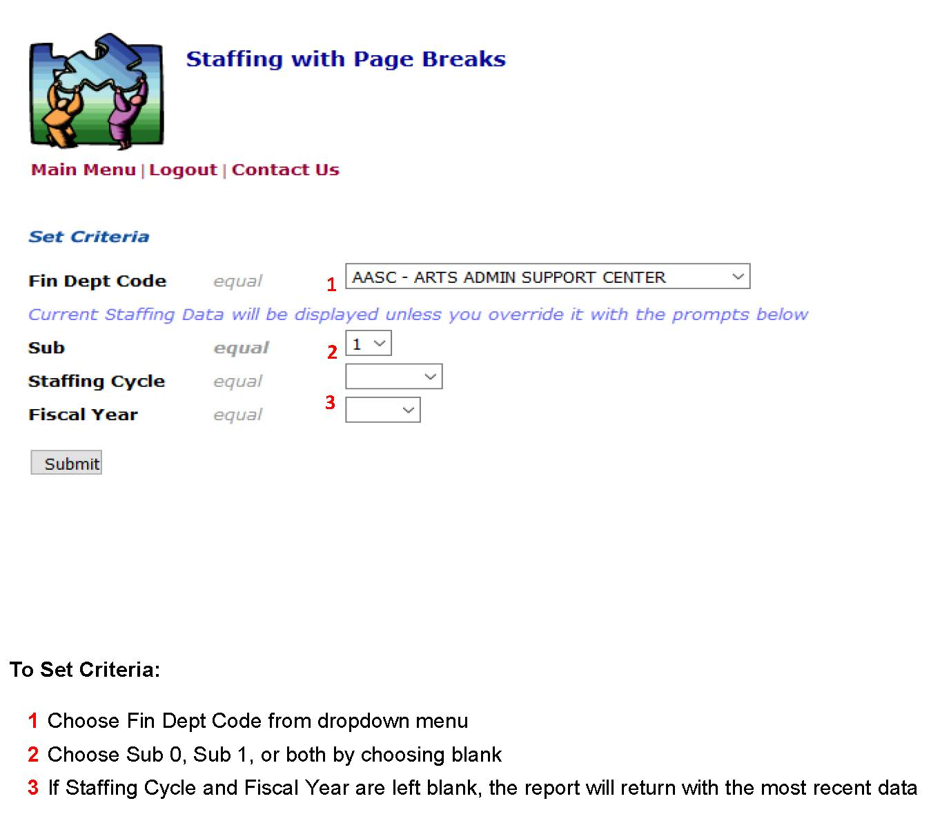

Slide 16
TOOLS
Open Provision Template
The Open Provision template is an Excel spreadsheet that is available from the Budget Office or your Control Point. Do not change any settings on the spreadsheet!
Provision identifier numbers must contain six digits; provision numbers cannot be duplicated within a Title Code. Letters & Science convention uses numbers that begin with 9999XX.
Provisions can be:
Added (A)
Changed (C)
Deleted (*)

Slide 17
TOOLS
Open Provision Template
Provisions must be created at Step 1 for step-based positions and at 25% into the range for range-based positions.
Either the Hourly Rate or the Monthly Rate (depending on Title Code) and corresponding Annual Rate must be entered for Regular provisions, along with FTE, Unit/Perb (CBA code), and Rep Code (covered or uncovered).
When deleting a provision, no information is necessary in the columns to the right of “Provision Description”.
The Budget Office processes Open Provision spreadsheets, uploading them into the Open Provision database.

Slide 18
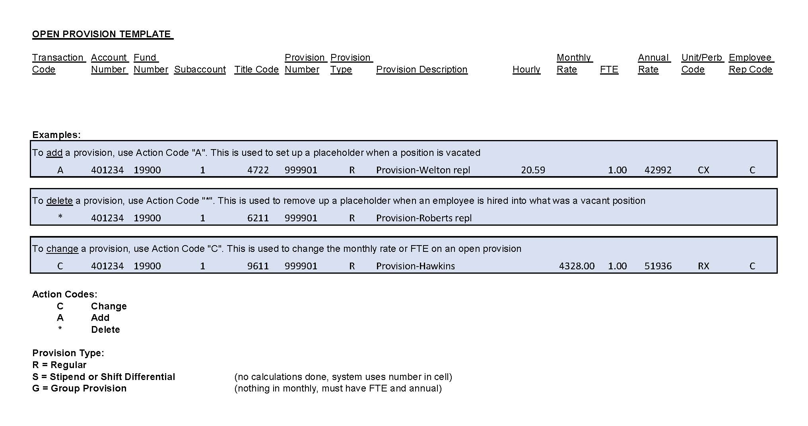

Slide 19
Open Provision Spreadsheet Example

Slide 20
TOOLS
Transfer of Funds System
The Transfer of Funds system can be found in the Espresso suite.
Access to TOF is assigned via the GMC-Assignments-ALLN02.
Additional information on the TOF system can be found on the Budget & Planning website.

Slide 21
TOOLS
Costing Reports
Costing Reports are system generated and provide funding for merits, range adjustments*, and lump sum payments for career employees covered by core funds**.
Core funds include: 19900, 19906, 19912, 19924, 20000, 20293, 69750, and 69993.
Copies of Costing Reports are available from your control point.
* Range adjustments include funds needed to bring an employee’s salary to the bottom of the salary range if they’ve fallen below that threshold when range minimums are increased
** For all other employees, their current fund source must cover any of these costs

Slide 22
Costing Report Example

Slide 23
TOOLS
Reconciliation Worksheet
The Excel “Reconciliation Worksheet” is a useful tool you may want to use while going through the reconciliation process as it will calculate new totals of both the Permanent Budget and Open Provision/PPS commitments as you make adjustments.
Start the process by entering in the PPS/Provision and Permanent Budget FTE and Amount listed on the Staffing List you are reconciling. As you go through each personnel action, enter into the spreadsheet the corresponding budget or provision/PPS action that needs to be taken. At a glance you can see when the report is balanced.
Note: when using the Reconciliation Worksheet to reflect a Provision Change, use two lines to reflect the subtraction of the old rate and addition of the new rate. On the Open Provision spreadsheet, the change action (C) will override the old provision line with the new rate; there is no need to delete and then add the revised amount.

Slide 24
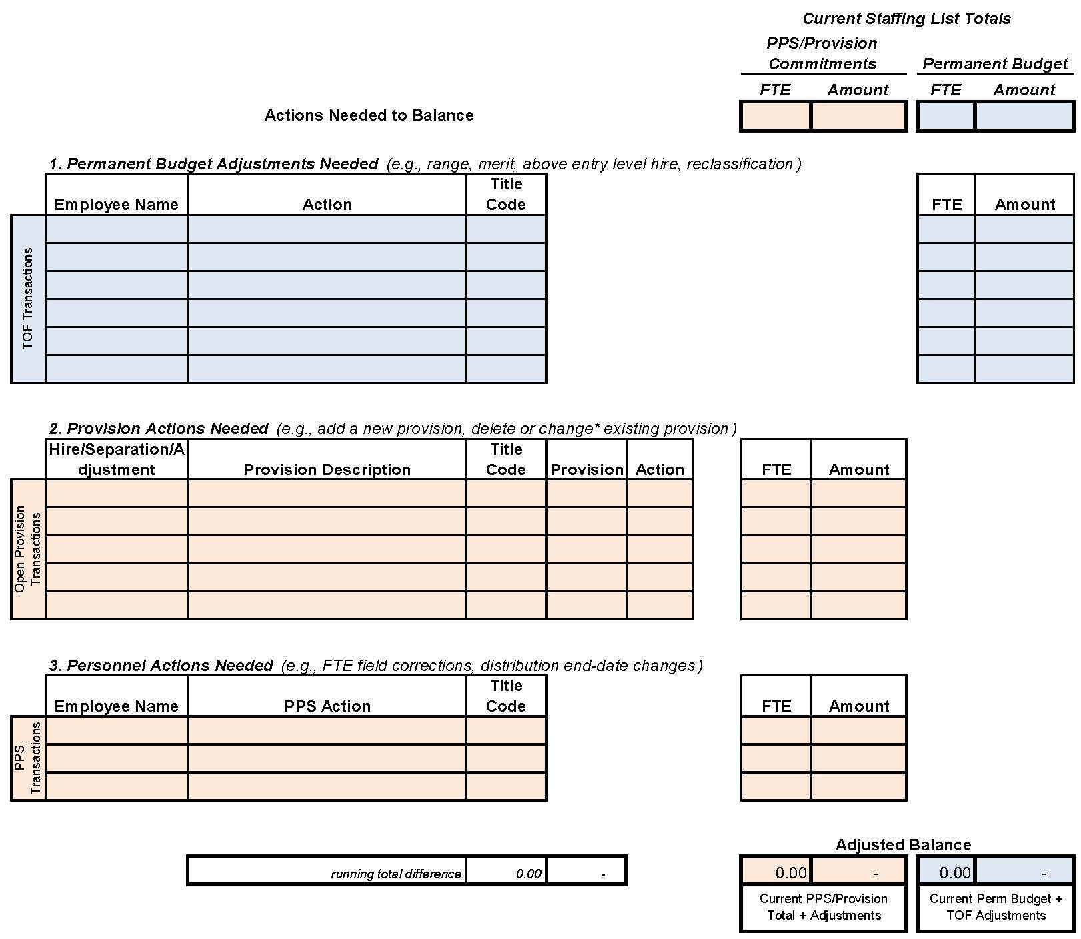
Reconciliation Worksheet

Slide 25
TOOLS
Salary Steps and Ranges
Current (and historical) salary steps and ranges can be found on the UCSB HR webpage under Compensation.
To calculate 25% into the range: Min salary + ((Max salary – Min Salary) x .25)
To calculate hourly rate:
divide annual rate by 2,088 or
divide monthly rate by 174

Slide 26
AGENDA
1) BASICS
What is it and why have it?
What makes it up?
Balancing the Staffing List
2) TOOLS
Data Warehouse
Open Provision template
Transfer of Funds system
Costing Reports
Reconciliation Worksheet
Salary steps and ranges
3) SUB 1 TRANSACTIONS
New hire
Separation or transfer
Reclassification
Equity adjustment
Merits & range adjustments
Change in FTE

Slide 27
SUB 1 TRANSACTIONS
New Hire
A new hire replaces an employee with the same Title Code:
If the new employee’s salary is less than the previous employee’s salary or Open Provision amount, subtract the difference from the budget. Prepare a TOF permanently debiting Sub 1 and crediting a support Sub (generally Sub 3). Annotate the report, showing your calculations, and add the debit to the Permanent Budget column.
If the new employee’s salary is greater than the previous employee’s or the Open Provision amount, add the difference to the budget and prepare a TOF permanently crediting Sub 1 and debiting a support Sub. Annotate the report, showing your calculations, and add the credit to the Permanent Budget column.
If the new employee’s salary is the same as the previous employee’s or the Open Provision amount there is no need for a TOF.
If the new employee is taking over a spot held by an Open Provision, use the Open Provision template to delete the provision that is now filled. Annotate the report by drawing a line through the provision to be deleted and subtract the FTE and salary from the PPS/Provision budget total.

Slide 28
SUB 1 TRANSACTIONS
Separation or Transfer
An employee vacates a range-based staff position:
If the former employee’s salary is less than 25% into the range, add the difference to the budget. Prepare a TOF permanently crediting Sub 1 and debiting a support Sub (generally Sub 3). Annotate the report, showing your calculations, and add the credit to the Permanent Budget column.
If the former employee’s salary is greater than 25% into the range, subtract the difference from the budget and prepare a TOF permanently debiting Sub 1 and crediting a support Sub. Annotate the report, showing your calculations, and add the debit to the Permanent Budget column.
If the former employee’s salary is at 25%, there is no need for a TOF.
Create an Open Provision place holder for the position at 25% into the range. Annotate the report by adding the FTE and salary, referencing the Title Code, and add the totals to the PPS/Provision total.

Slide 29
SUB 1 TRANSACTIONS
Separation or Transfer
An employee vacates a step-based staff position:
If the former employee’s step is higher than Step 1, subtract the difference between that current step and Step 1 and prepare a TOF permanently debiting Sub 1 and crediting a support Sub. Annotate the report, showing your calculations, and add the debit to the Permanent Budget column.
If the former employee’s salary is at Step 1, there is no need for a TOF.
Create an Open Provision place holder for the position at Step 1. Annotate the report by adding the FTE and salary, referencing the Title Code, and add the totals to the PPS/Provision total.

Slide 30
SUB 1 TRANSACTIONS
Reclassification
Prepare a TOF permanently debiting the old FTE and salary in Sub 1 and crediting the new FTE and salary in Sub 1, referencing the Title Code on each line. Permanently debit a support Sub for the difference in salary. Annotate the report, showing your calculations, and add the debit (old Title Code) and credit (new Title Code) for both the FTE and salary in the Permanent Budget column.
If there is no difference in salary, a TOF should still be prepared in the same manner as above (with the exception of the support Sub line) so there is a record of the change in Title Code.
In the unusual case of a downward reclassification, follow the same instructions as above and credit a support Sub for the difference.

Slide 31
SUB 1 TRANSACTIONS
Reclassification
If the reclassification involves an Open Provision, prepare a TOF permanently debiting the old FTE and salary in Sub 1 and crediting the new FTE and salary at Step 1 or 25% into the range in Sub 1, referencing the Title Code on each line. Permanently debit a support Sub for the difference in salary. Annotate the report, showing your calculations, and add the debit (old Title Code) and credit (new Title Code) for both the FTE and salary in the Permanent Budget column.
Using the Open Provision template, delete the old provision and create a new provision.

Slide 32
SUB 1 TRANSACTIONS
Equity Increase
Prepare a TOF permanently debiting the old salary in Sub 1 and crediting the new salary in Sub 1. Permanently debit a support Sub for the difference in salary. Annotate the report, showing your calculations, and add the credit to the Permanent Budget column.

Slide 33
SUB 1 TRANSACTIONS
Merits and Range Adjustments
Merits and range adjustments are generally funded centrally via the system-generated Costing Report for both the current fiscal year and permanent budget. In some cases these can be processed incorrectly or not processed at all. If a merit or range adjustment does not show up on the Costing Report, prepare a one-sided TOF permanently crediting Sub 1 for the amount, making sure to list the employee’s name and Title Code in the Description box. The Budget Office will complete the TOF with their account. Annotate the report, showing your calculations, and add the credit to the Permanent Budget column. In addition, make note of the reason that the merit or range adjustment was not funded via the Costing Report (e.g., employee has a PPS end date due to a visa issue, merit approved after system deadline).

Slide 34
SUB 1 TRANSACTIONS
Change in FTE
Creating an FTE
A department may create a staff FTE if it has sufficient funds in its permanent budget. To create an FTE, prepare a TOF crediting Sub 1 with the salary as approved by HR for a new hire, adding the Title Code and Perm FTE. Permanently debit the appropriate support Sub for the same amount but leave the FTE blank for the debit line. Add the credit to the Permanent Budget column of the Staffing List report.
If there is not an incumbent in the position, create an Open Provision place holder for the position at Step 1 or 25% into the range. Annotate the report by adding the FTE and salary, referencing the Title Code, and add the totals to the PPS/Provision total.

Slide 35
SUB 1 TRANSACTIONS
Change in FTE
Deleting an FTE
If a career staff position is no longer needed or has been pledged to a permanent budget reduction, the FTE and salary should be debited from Sub 1. Prepare a TOF debiting Sub 1 for the salary and FTE, crediting the appropriate support Sub and leaving the FTE blank in the credit line. Annotate the report, showing the debit in the Permanent Budget column of the Staffing List report.
Increasing or reducing an FTE
A department may increase or reduce a staff FTE by following the same process as creating or deleting an FTE.

Slide 36
AGENDA
RECONCILIATION EXERCISES
Helpful Hints
Getting Started
Example Set 1
Separation
New Hire
Open Provision update
Example Set 2
Equity increase
Range Adjustment correction
Reclassification

Slide 37
RECONCILING
Helpful Hints
On the Staffing List report, the Fiscal Year shown is the last year of the 12 month cycle, i.e., Fiscal Year 2017 refers to the 2016-17 fiscal year.
July 1 = 7/1/16 Mar 31 = 3/31/17
Oct 31 = 10/31/16 May 31 = 5/31/17
Dec 31 = 12/31/16
Walk through each employee or provision, person by person – some won’t need any action, helping focus on those that need attention.
Remember to check that each PPS distribution has an FTE entry. That can be overlooked in PPS and not affect pay.

Slide 38
RECONCILING
Helpful Hints
Career employees with visa end dates may not show up on staffing so need to be added as provisions. Those provisions need to be updated after a pay rate change.
When creating a Transfer of Funds, always add the Title Code in the TC column to any line item associated with Sub 1.
Reconciling the Staffing List means balancing it on a permanent basis. Departments are still encouraged to track their current year budgets, paying special attention to funding due for merits and range adjustments.
Remember that certain staffing changes affect the department’s permanent budget!

Slide 39
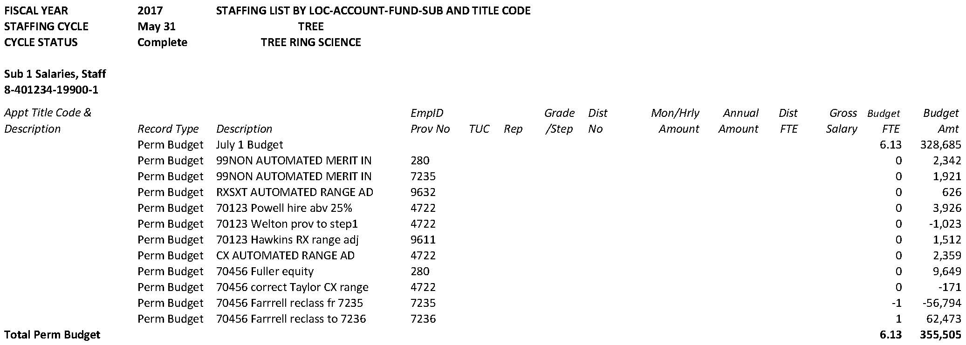
RECONCILING
Helpful Hints
The Description line in the Permanent Budget section of the Staffing List includes the Transfer of Funds number if the entry is associated with a TOF.
TOF 70123 entries
TOF 70456 entries

Slide 40
RECONCILING
Getting Started
Gather together:
Most recent balanced Staffing List (this is usually the July 1 SL for the current fiscal year)
Current Staffing List
Costing Reports
Salary Scales
Personnel action information: new hires, separations, reclassifications, equity increases, merits, range adjustments, etc.

Slide 41
AGENDA
SUB 1 RECONCILIATION EXAMPLES
Example Set 1
Separation
New Hire
Open Provision update

Slide 42
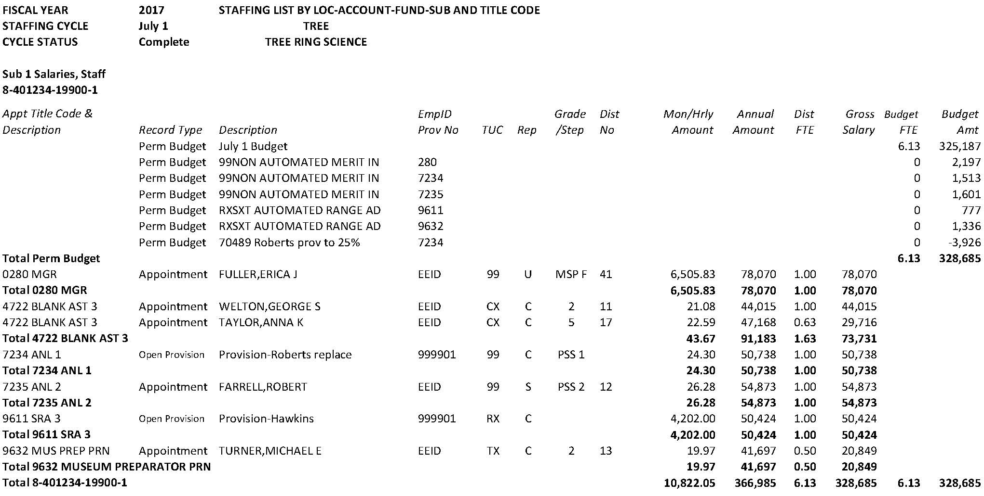
Most recent Balanced Staffing List

Slide 43
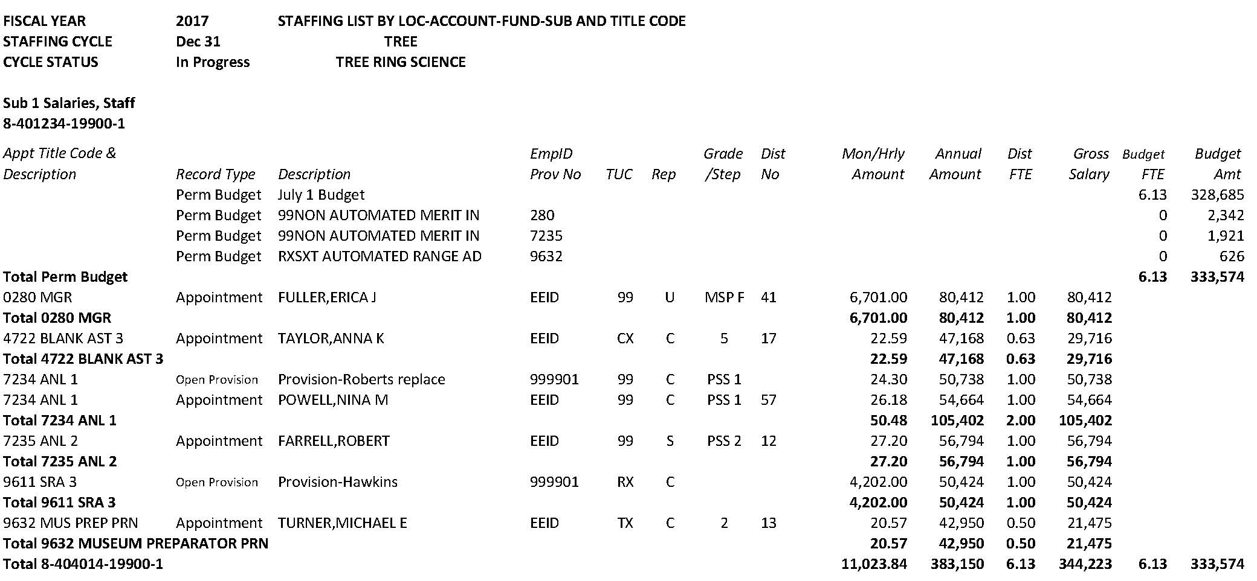
Current Staffing List

Slide 44
Costing Report for 7/1/16 Merit

Slide 45
Costing Report for 10/1/16 Range Adjustment

Slide 46
Costing Report for 10/1/16 Range Adjustment

Slide 47
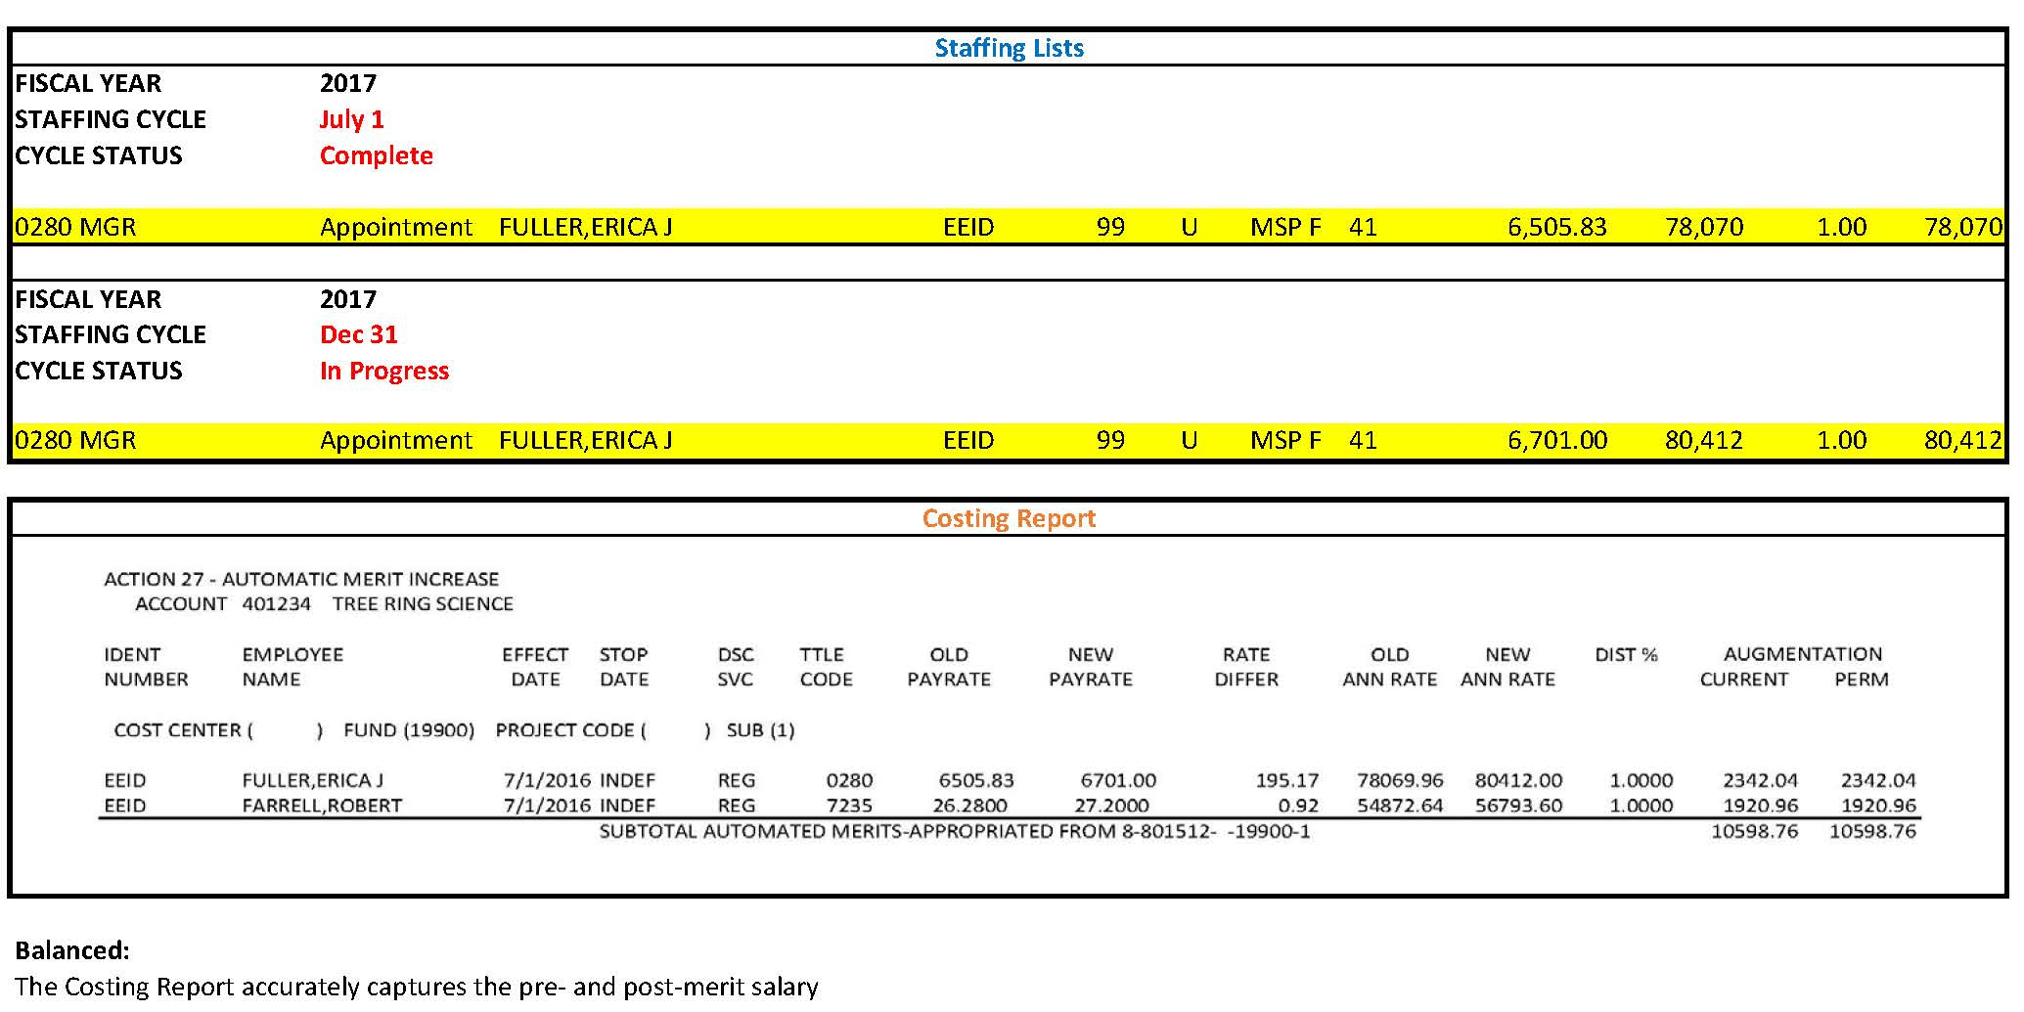
employee #1 with salary action

Slide 48
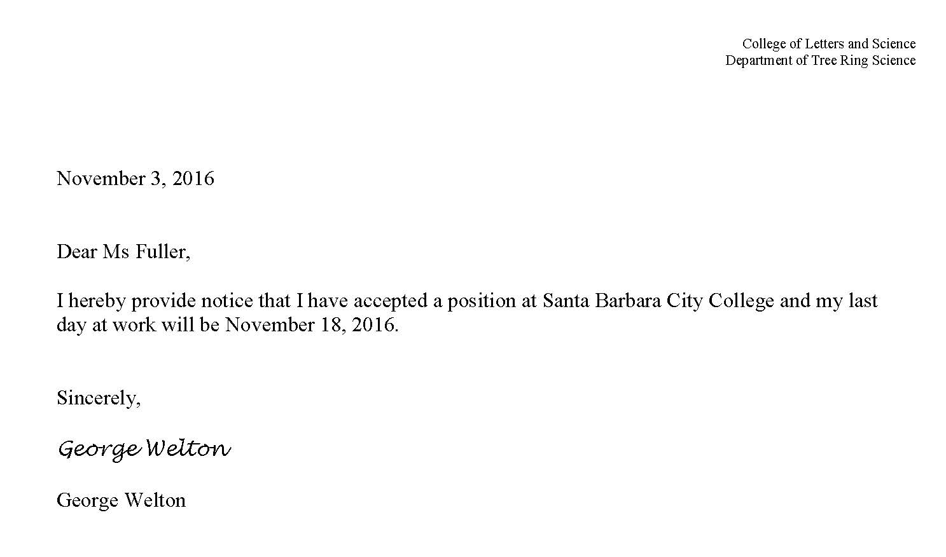
employee #2 with salary action

Slide 49
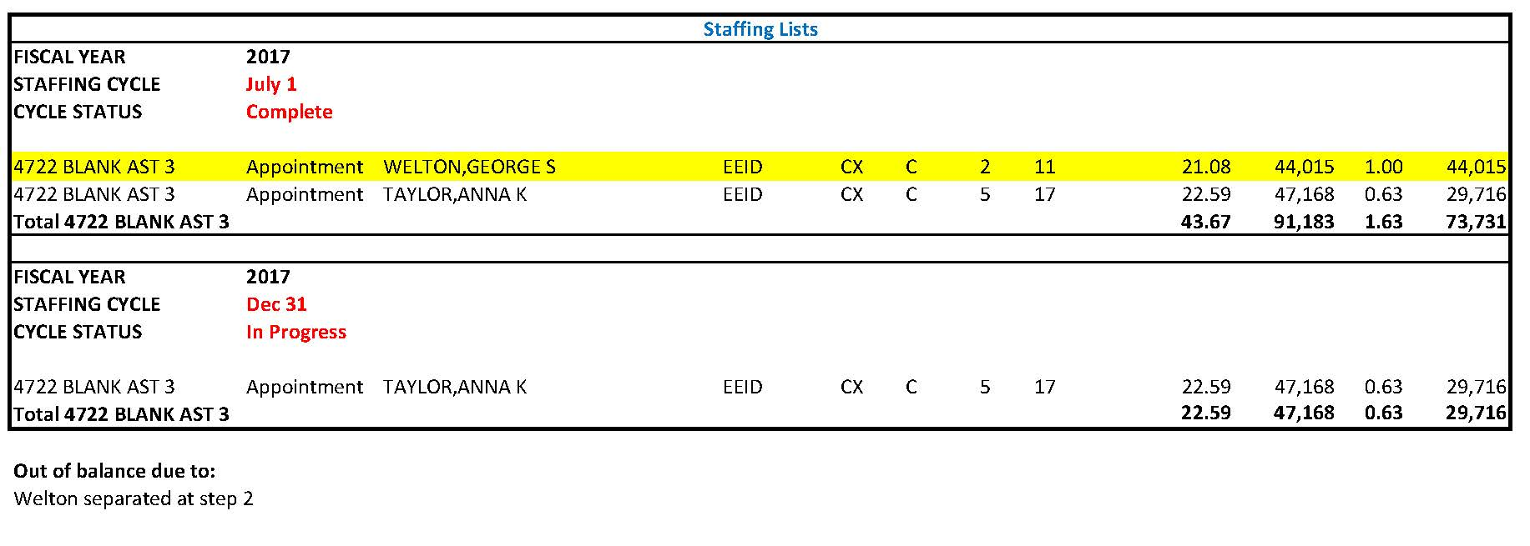
employee #2 with salary action

Slide 50
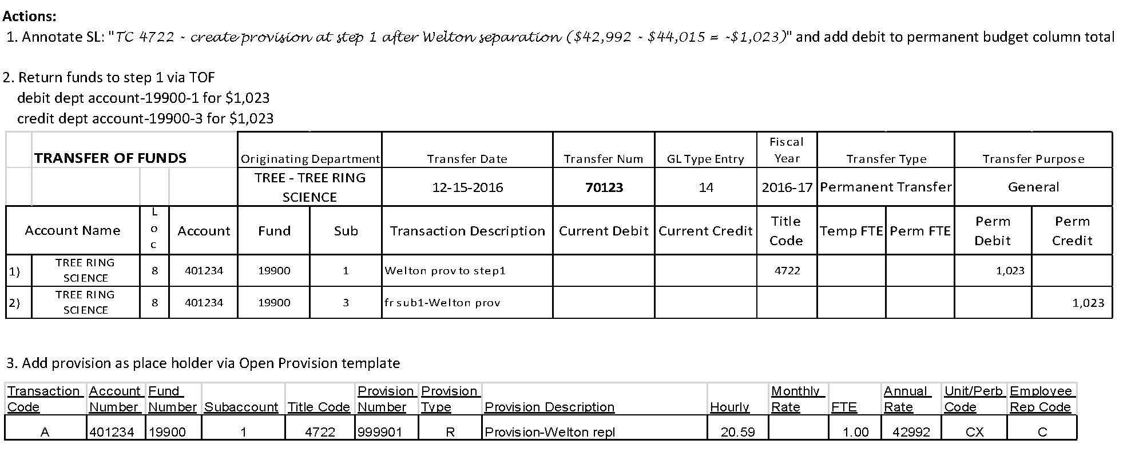
employee #2 with salary action

Slide 51
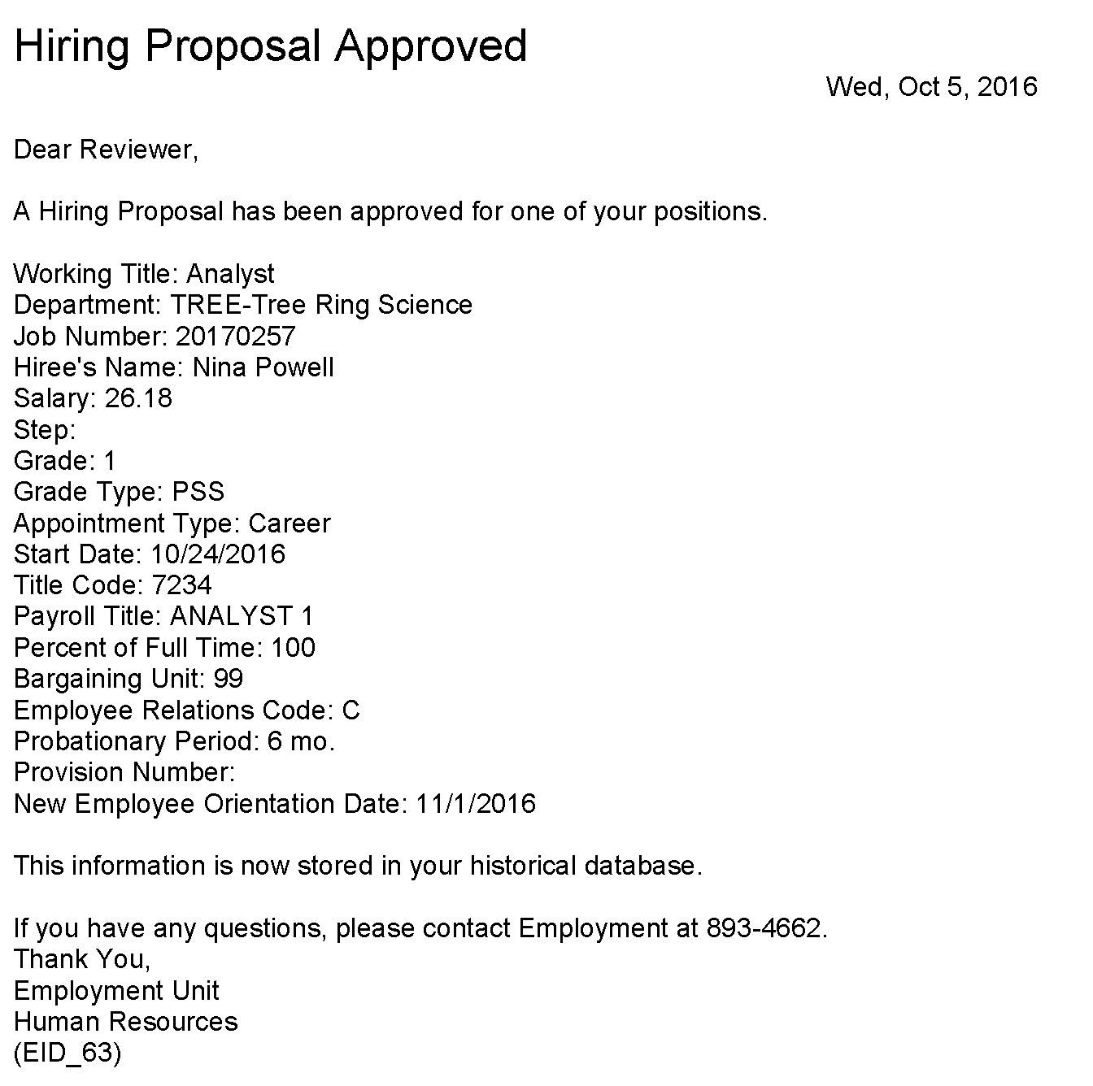
employee #3 with salary action

Slide 52
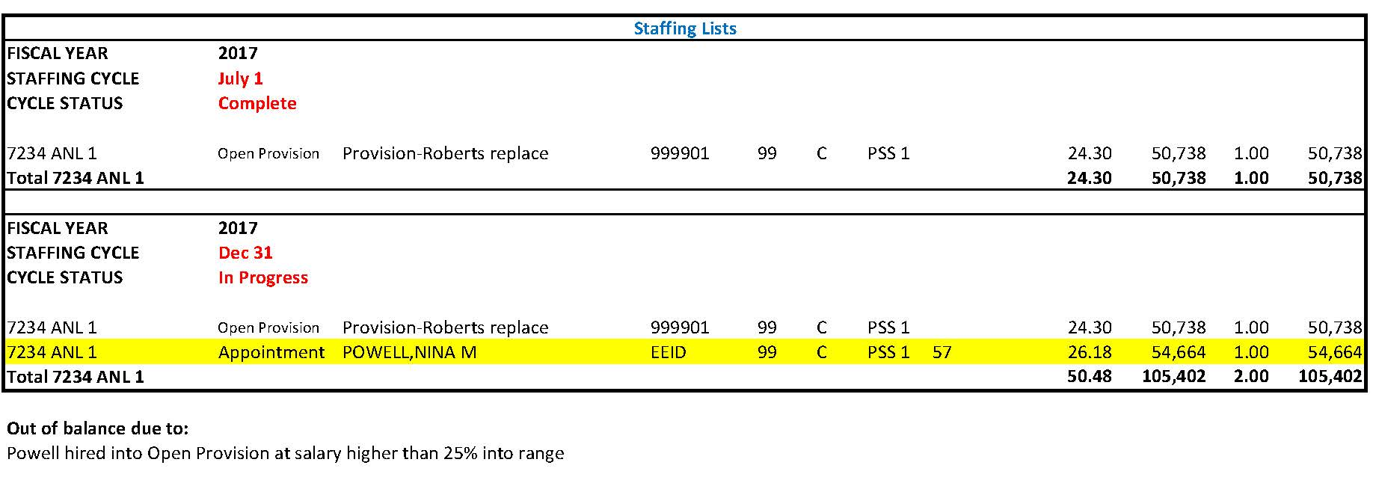
employee #3 with salary action

Slide 53
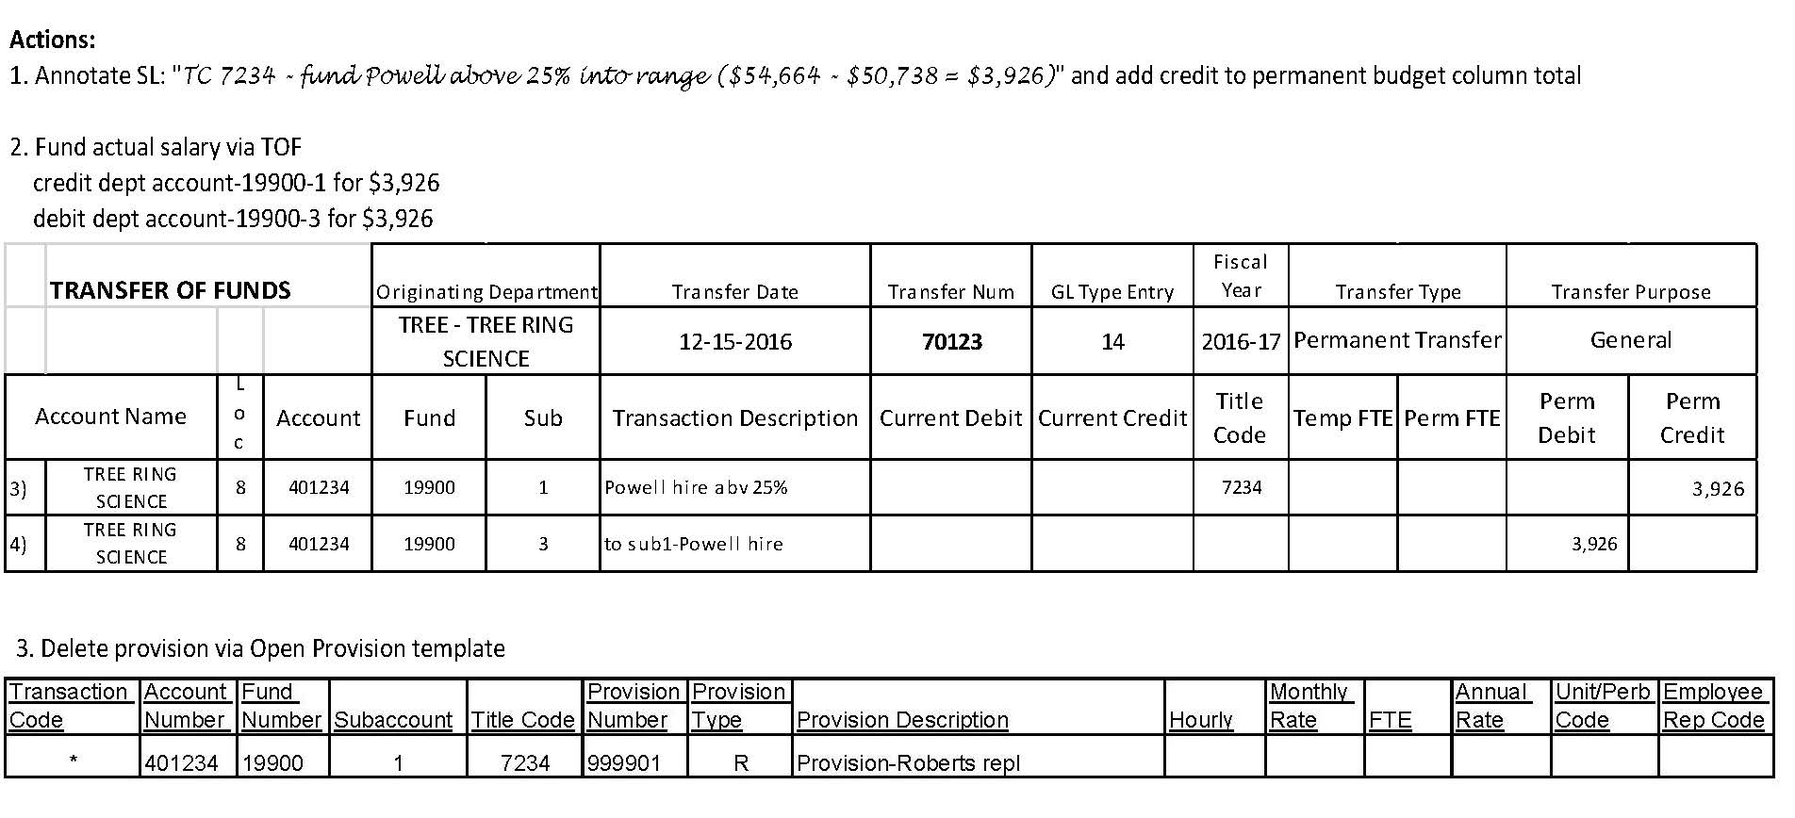
employee #3 with salary action

Slide 54
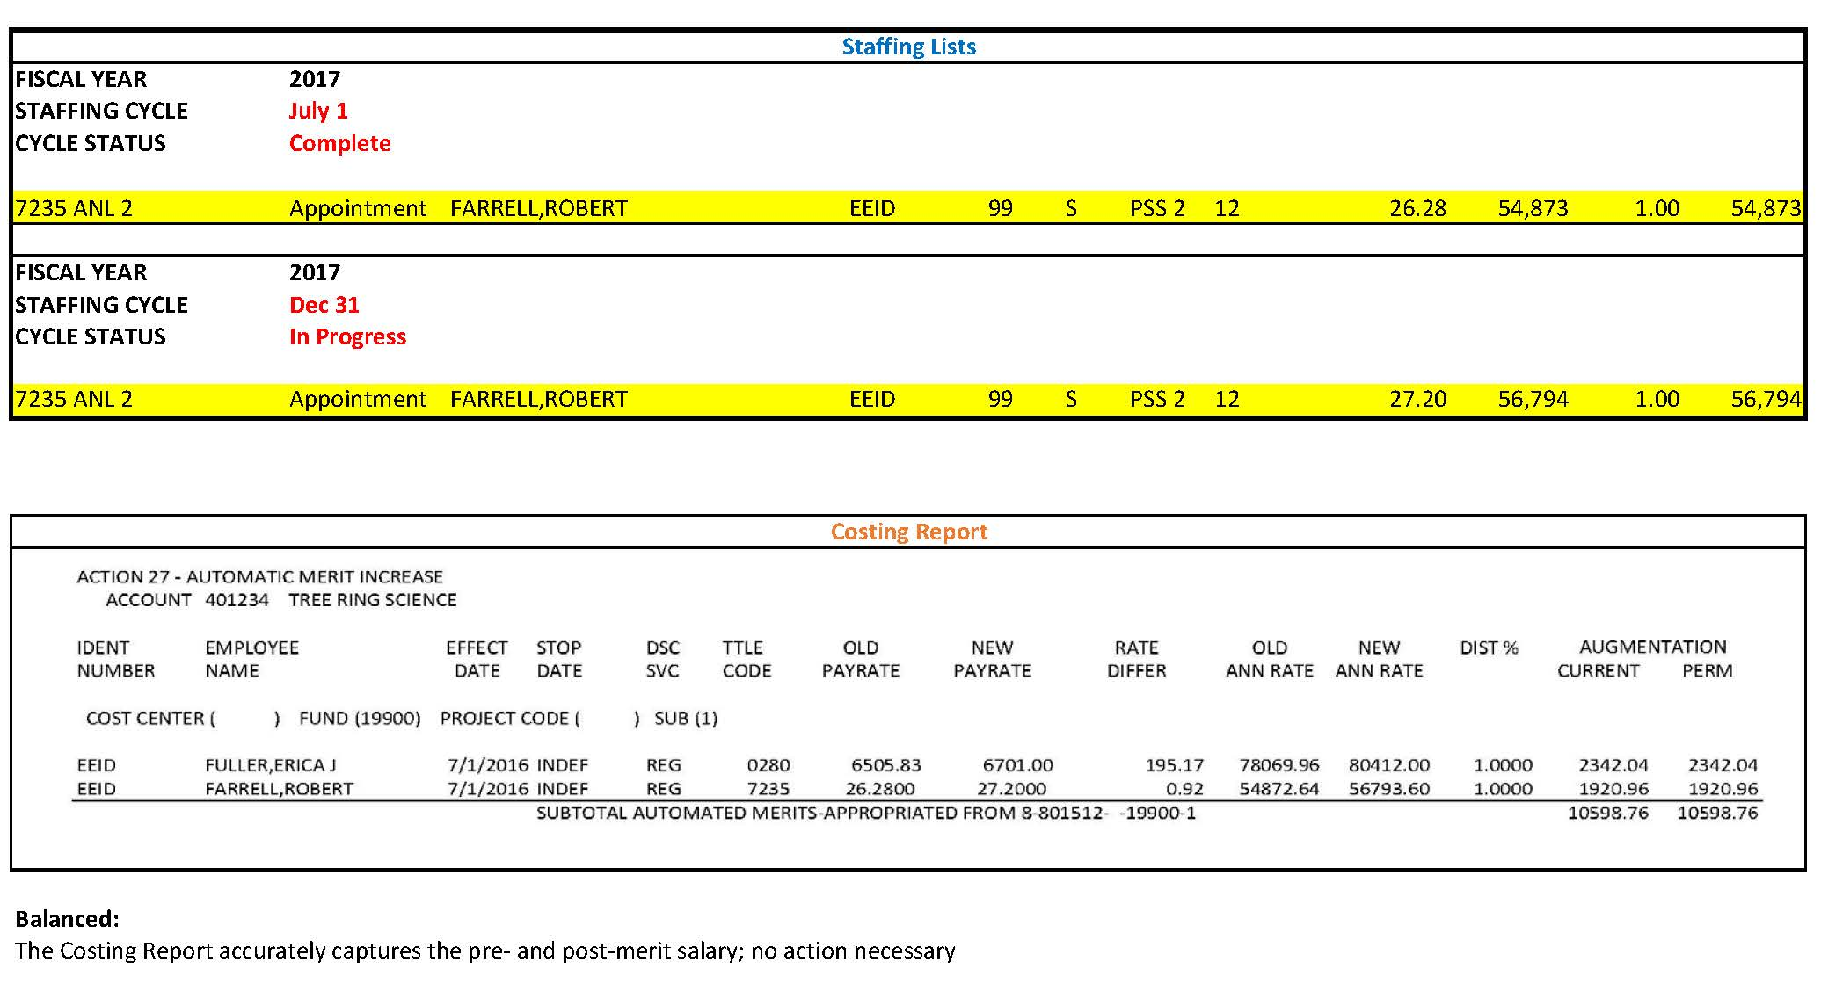
employee #4 with salary action

Slide 55
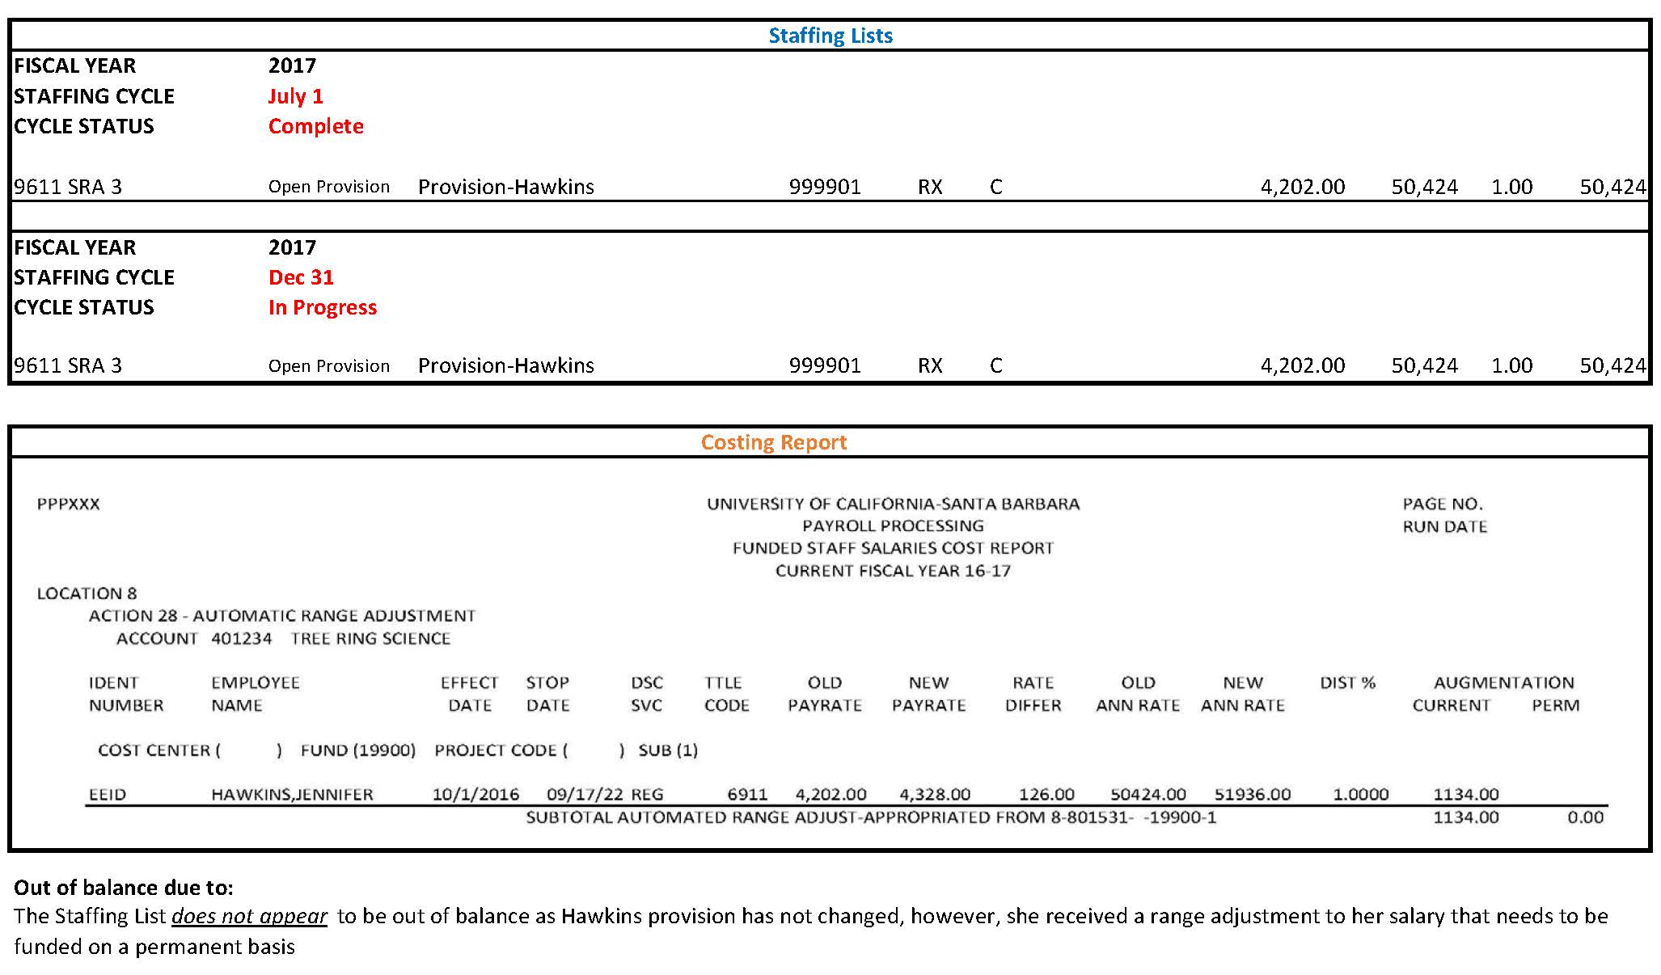
employee #5 with salary action

Slide 56
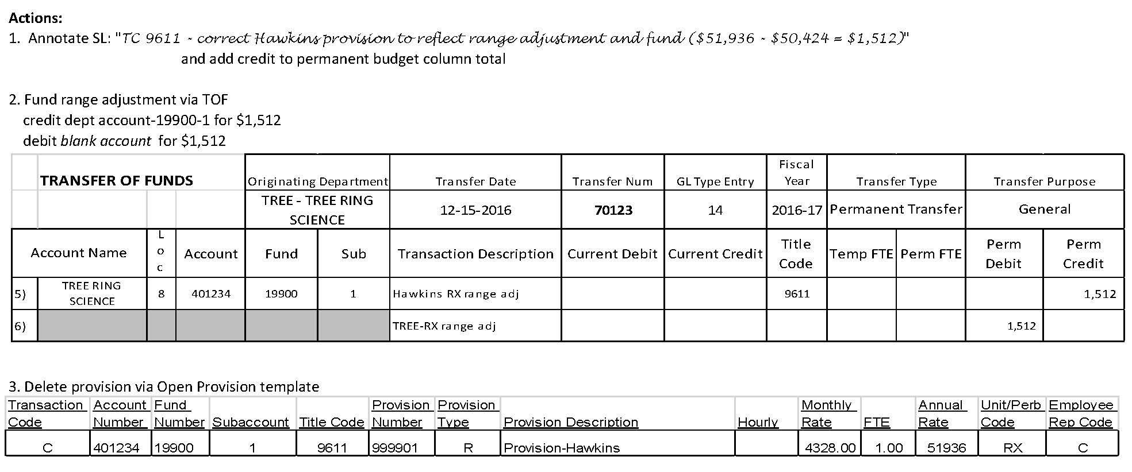
employee #5 with salary action

Slide 57
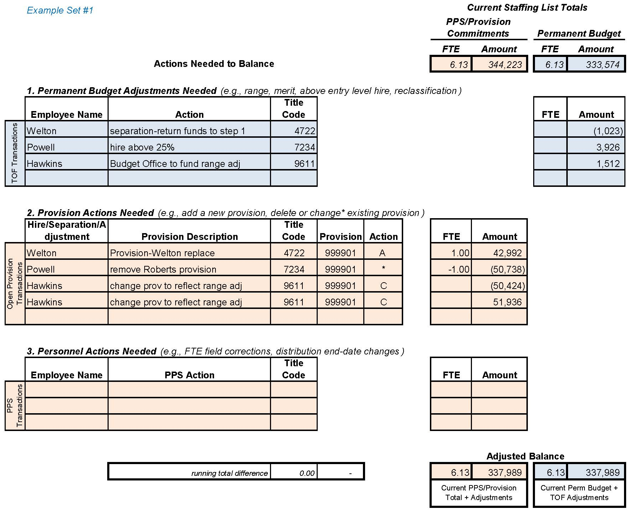
Reconciliation Worksheet

Slide 58
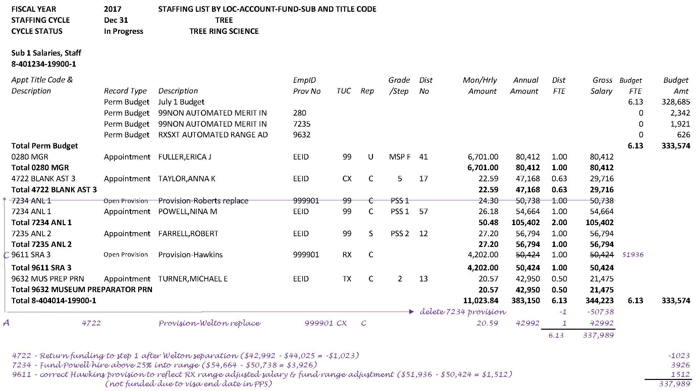
Annotated Staffing List

Slide 59
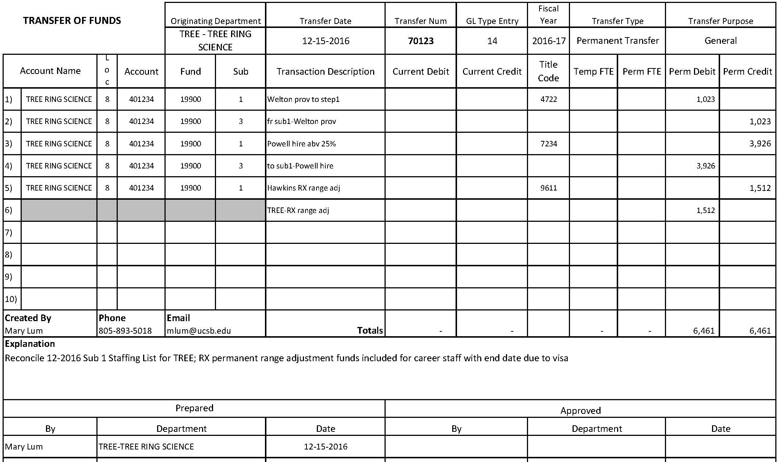
Completed Transfer of Funds

Slide 60
Completed Open Provision spreadsheet

Slide 61
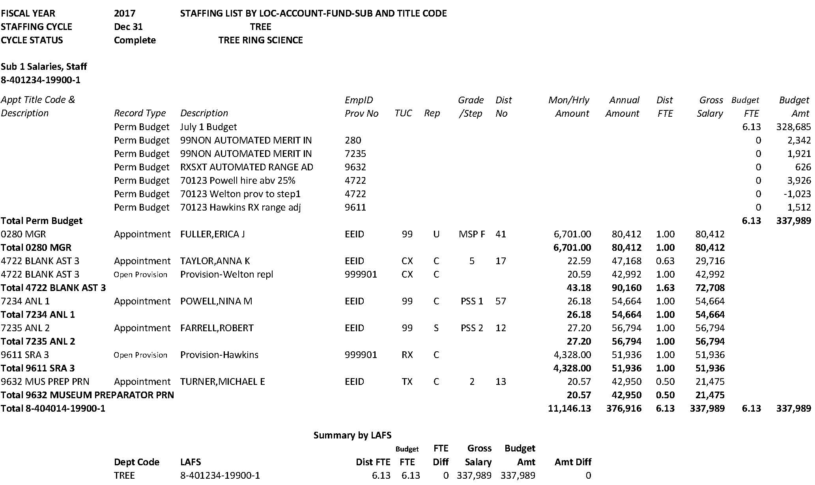
Balanced Staffing List reflecting processed TOF and Provision spreadsheet

Slide 62
AGENDA
SUB 1 RECONCILIATION EXAMPLES
Example Set 2
Equity increase
Range Adjustment correction
Reclassification

Slide 63
Most recent Balanced Staffing List

Slide 64
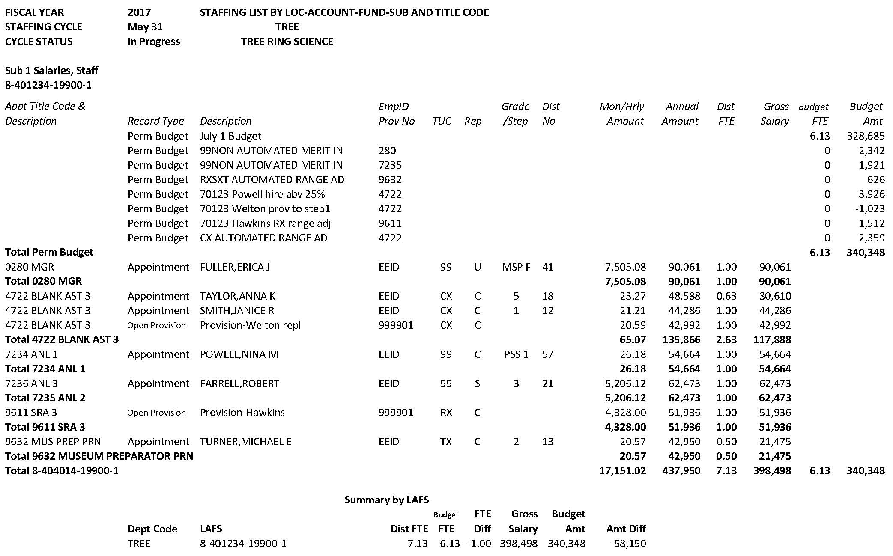
Current Staffing List

Slide 65
Costing Report for 4/1/17 Range Adjustment

Slide 66
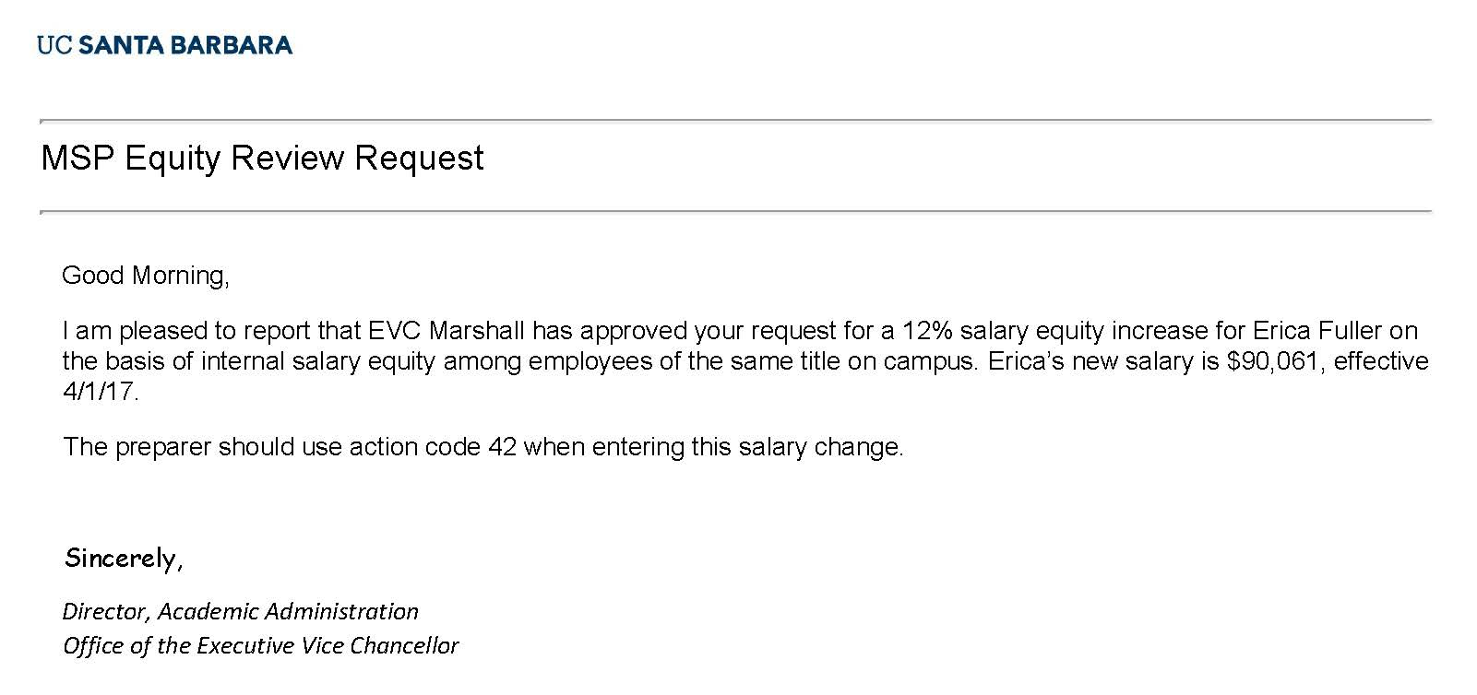
employee #6 with salary action

Slide 67
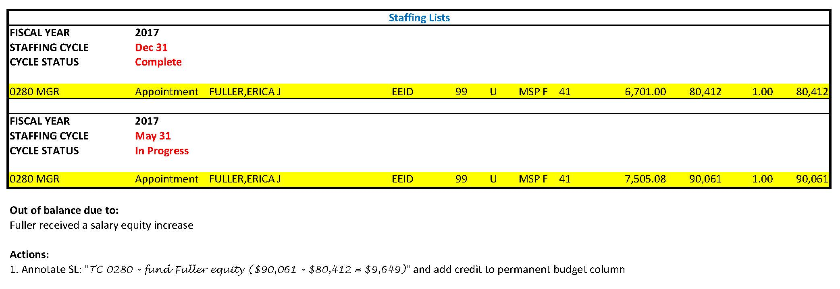
employee #6 with salary action

Slide 68
employee #6 with salary action

Slide 69
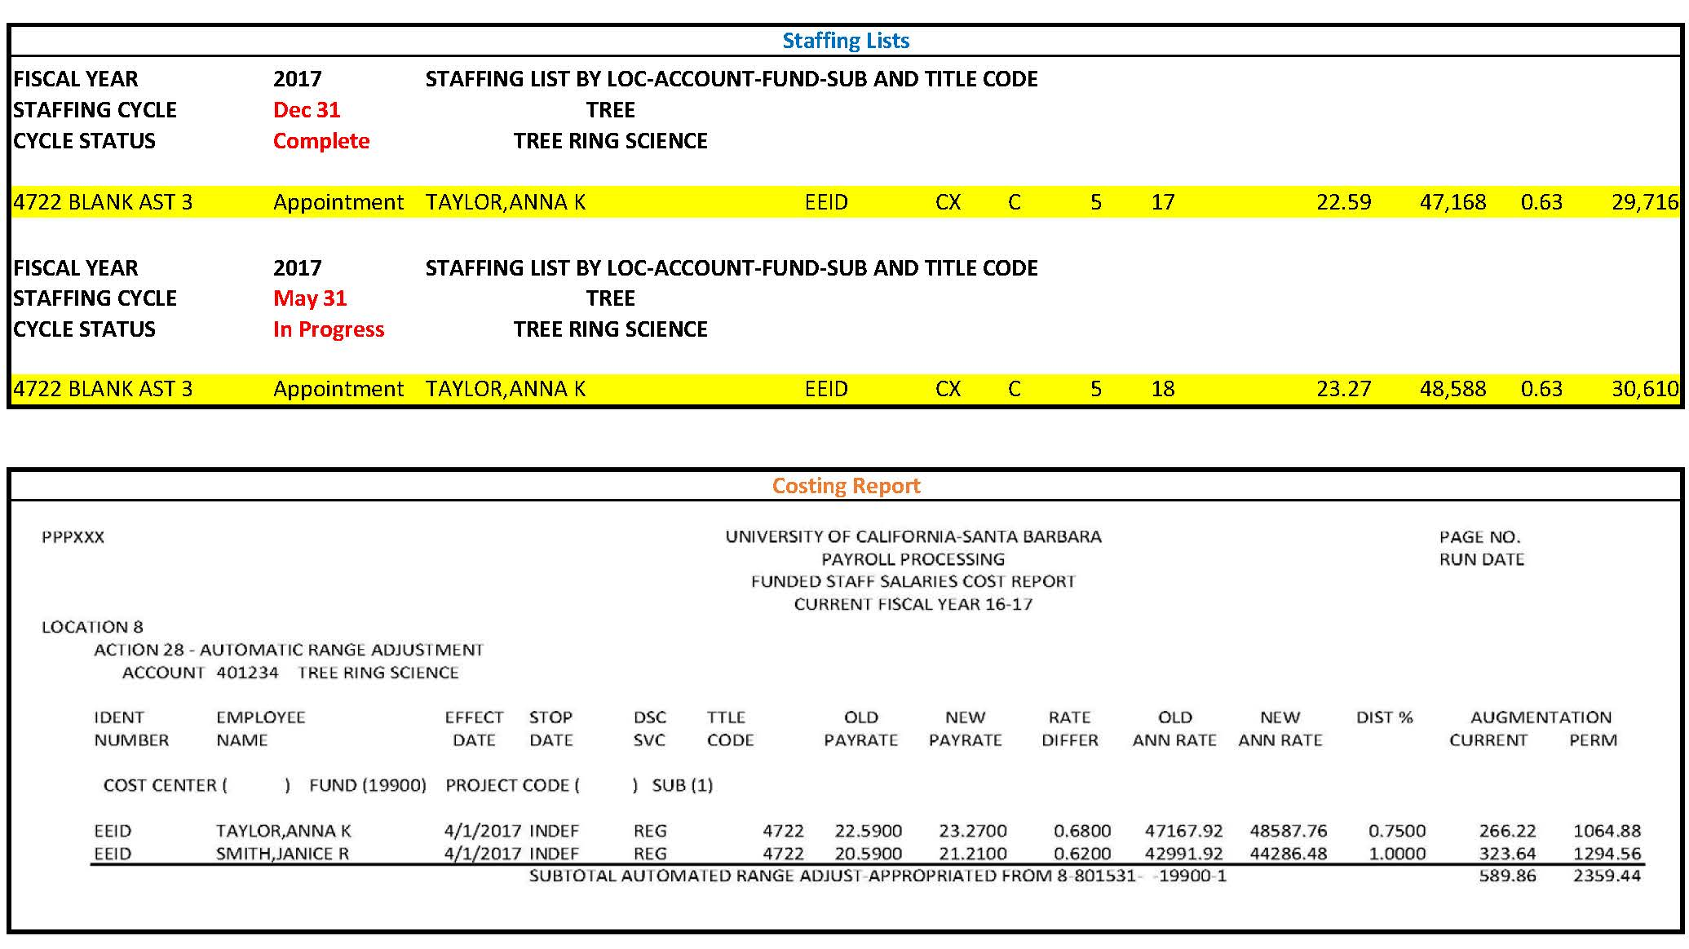
employee #7 with salary action

Slide 70
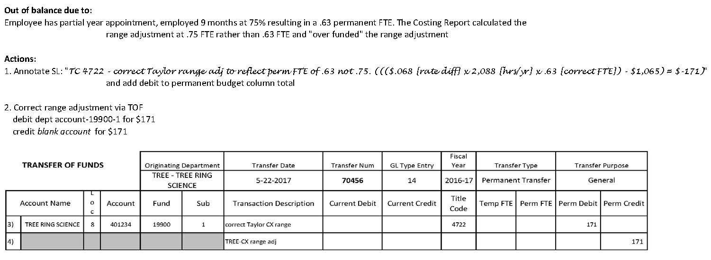
employee #7 with salary action

Slide 71
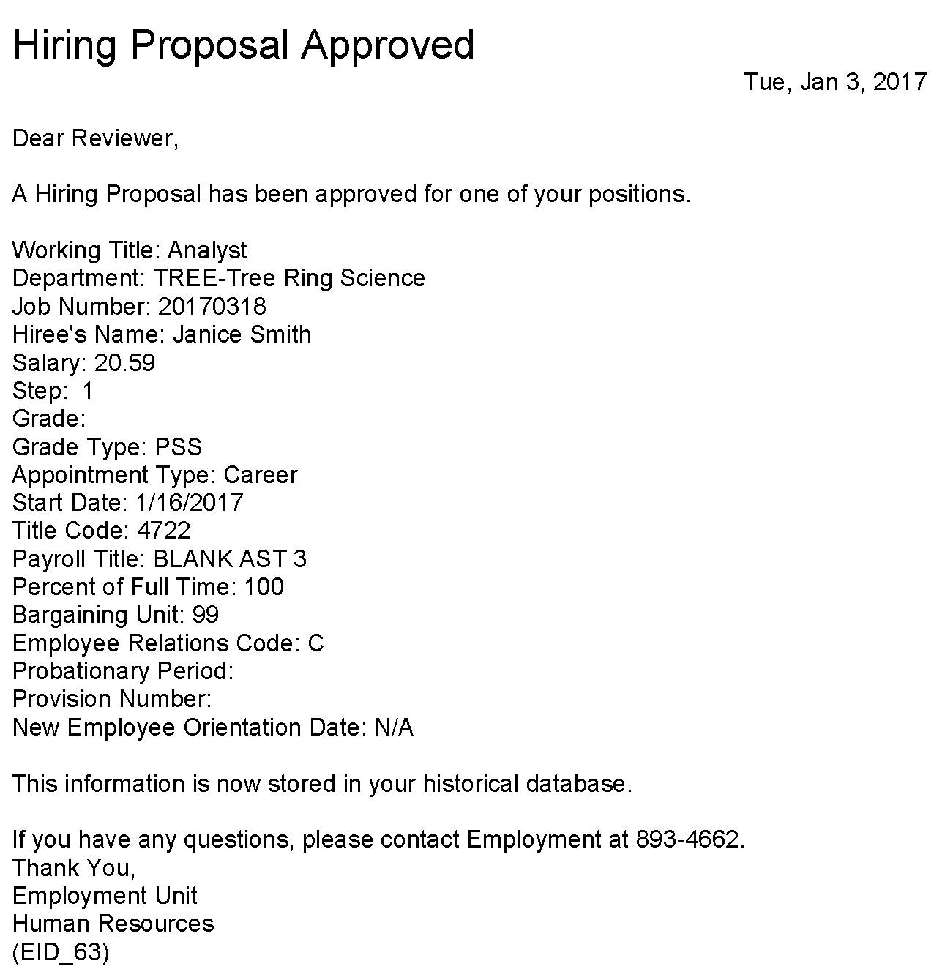
employee #8 with salary action

Slide 72
employee #8 with salary action

Slide 73
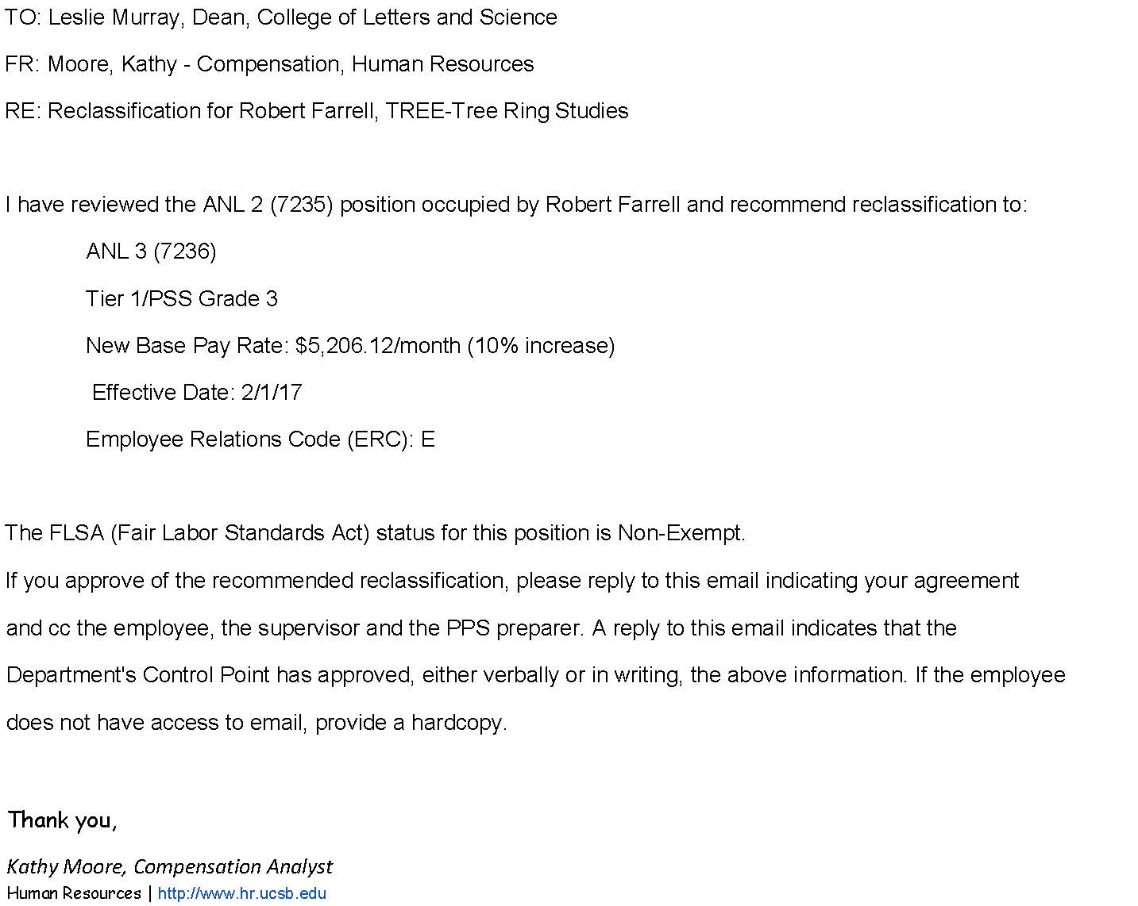
employee #9 with salary action

Slide 74
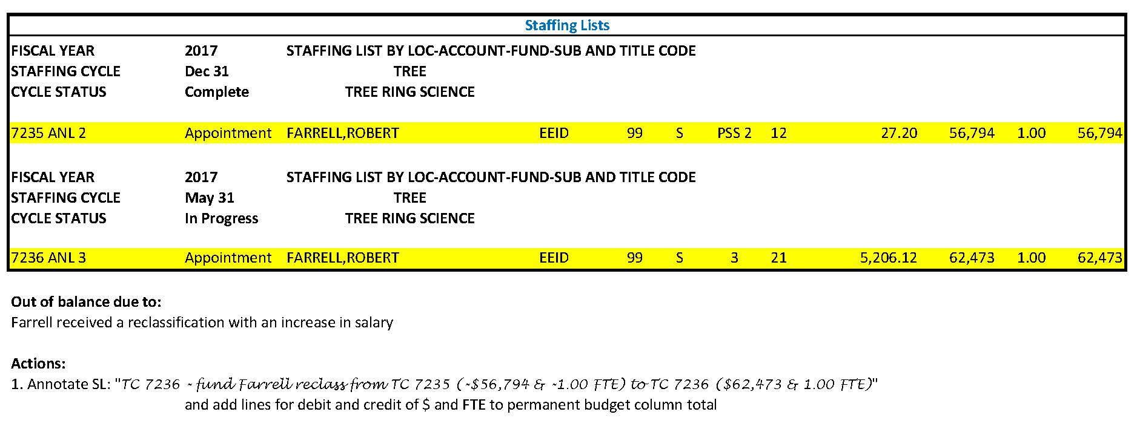
employee #9 with salary action

Slide 75
employee #9 with salary action

Slide 76
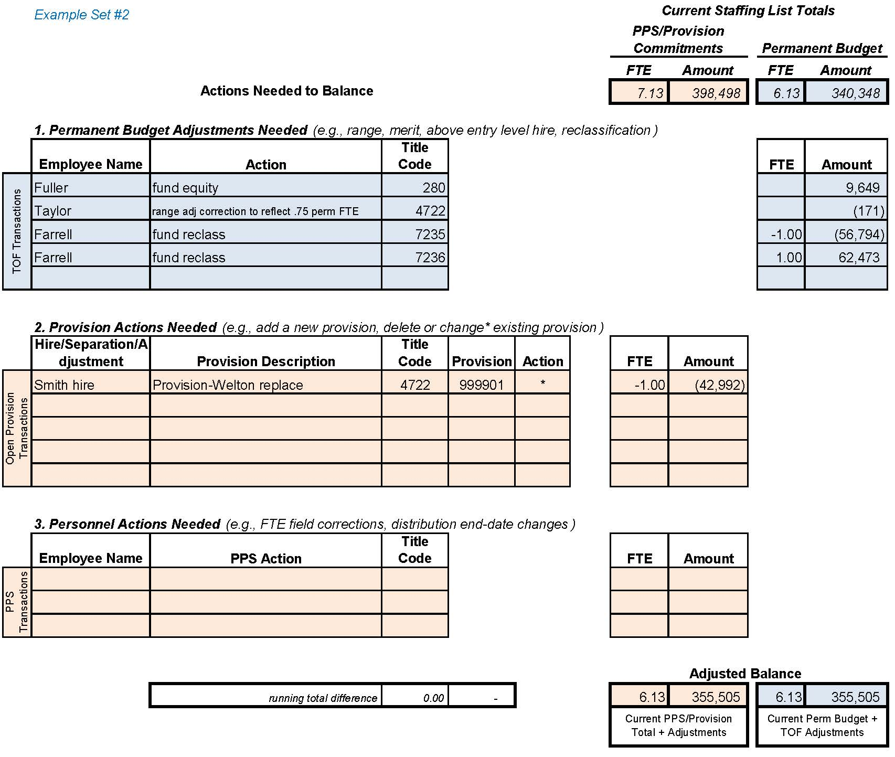
Reconciliation Worksheet

Slide 77
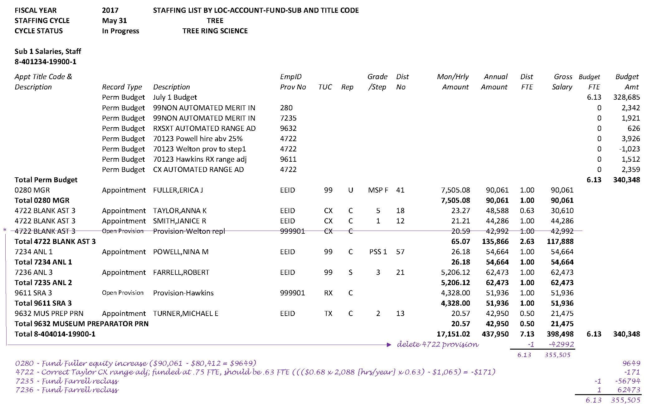
Annotated Staffing List

Slide 78
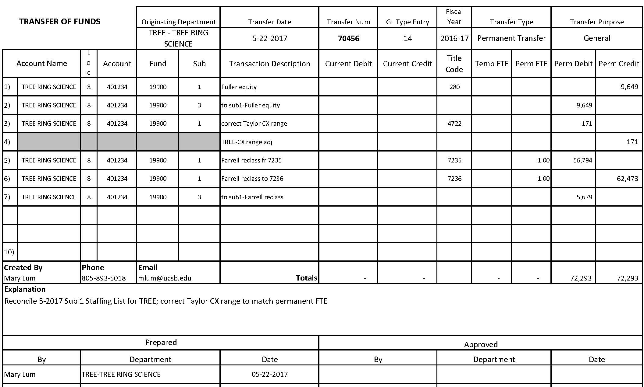
Completed Transfer of Funds

Slide 79
Completed Open Provision spreadsheet

Slide 80
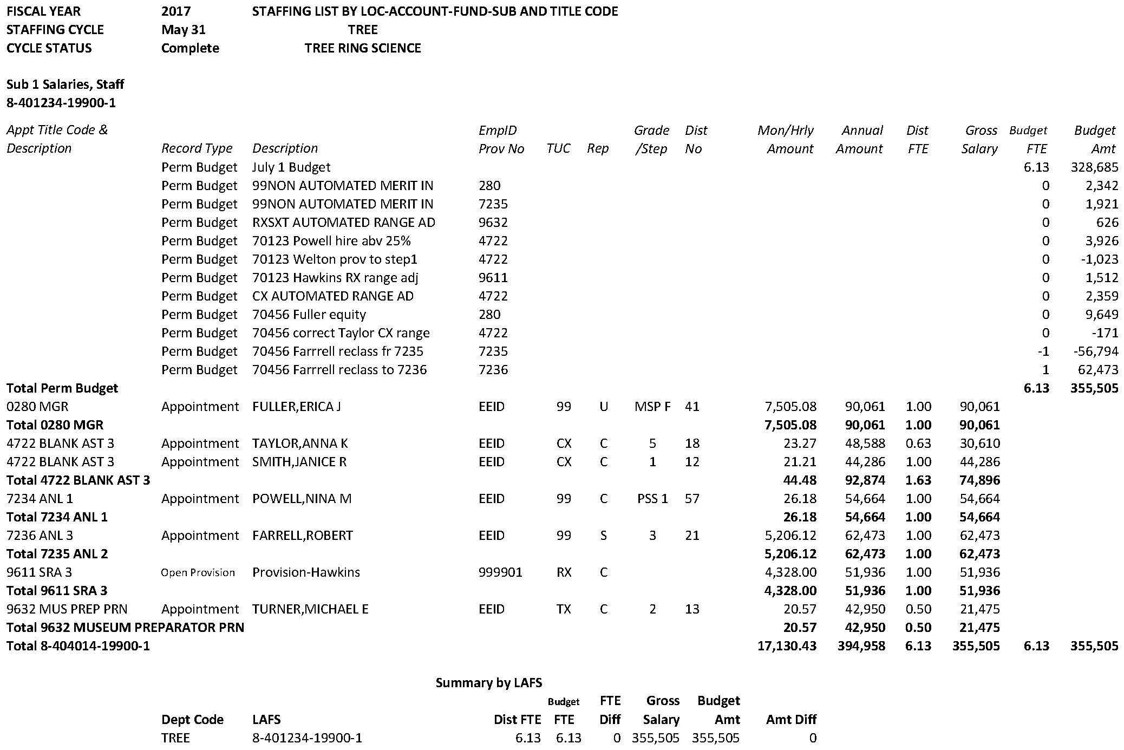
Balanced Staffing List reflecting processed TOF and Provision spreadsheet

Slide 81
Congratulations on reconciling your Staffing List!
The Budget Office has requested that the Staffing List be reconciled on a quarterly basis. All backup (Transfer of Funds, Open Provision spreadsheet, and pdf of annotated report) should be forwarded to your divisional contact for review before the deadline.
Please contact your Letters & Science divisional Assistant Dean if you have questions or comments.

